Slide 1
Supplier information management
Aalto software project 2023
Saana Kivimaa
Senior Product Manager

Slide 2






SIEVO?

Slide 3











Trusted by 150+ large global customers
19 000
global users
1230M
lines of data managed daily
350B€
spend managed yearly

Slide 4




Sievo in short
Sievo enables companies to analyze and optimize their procurement data, driving savings & sustainable decision-making.
We’re a SaaS company that specializes in procurement* analytics.
We build our software product in-house and provide advanced analytics solutions to our customers.
*procurement: buying goods and services from suppliers

Slide 5

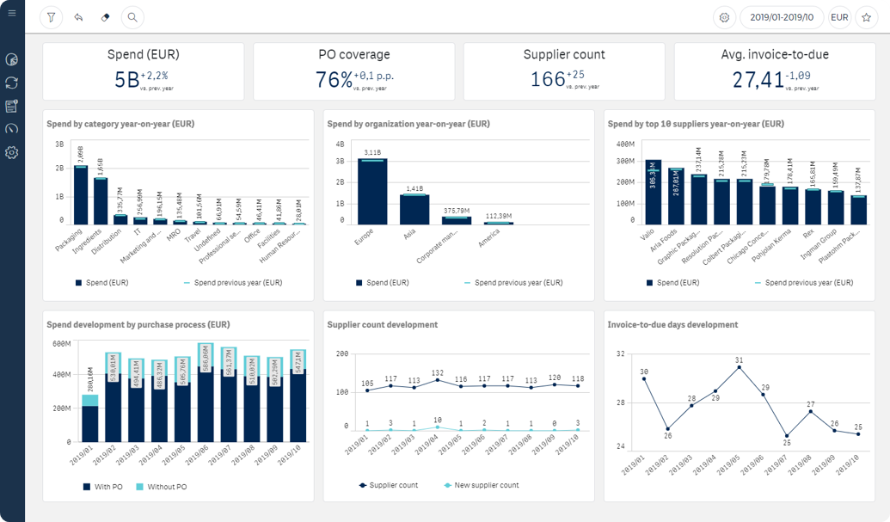
Procurement analytics?

Slide 6
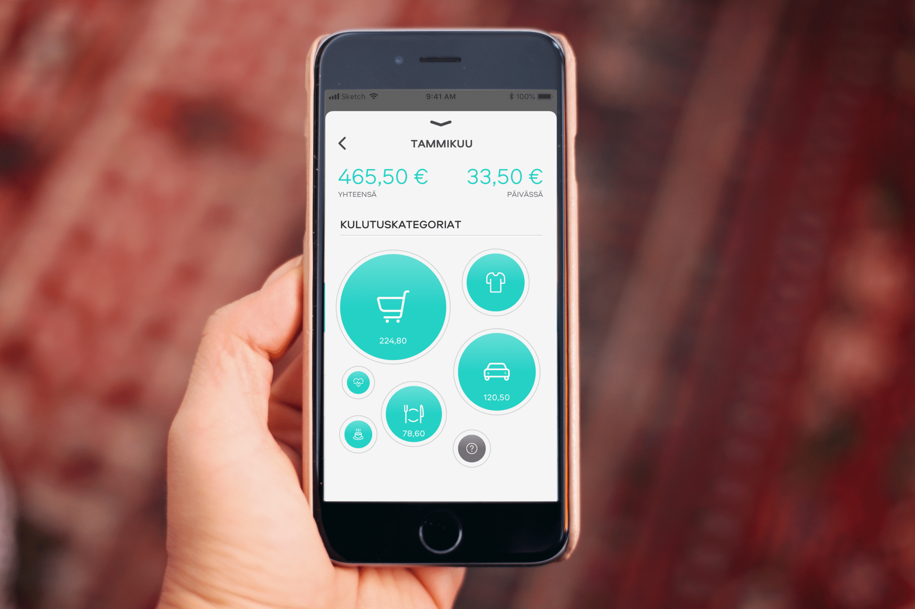
In short, we describe where the money went

Slide 7

diverse • fun • central • caring
Notes:
20 nationalities, 30% women
Office in centre
Refreshments, beer, food

Slide 8
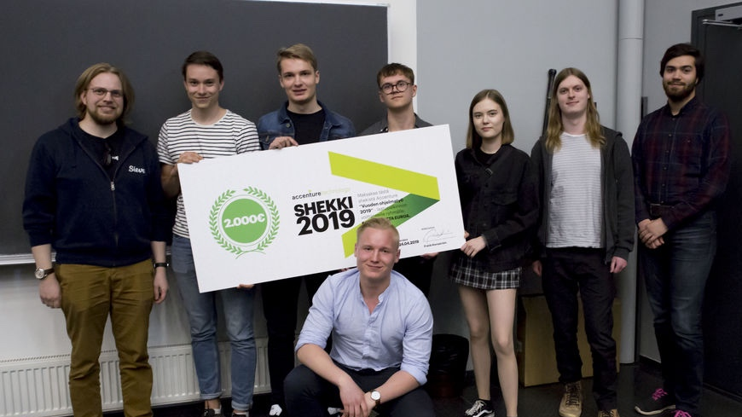
Previous projects have been successes

Slide 9
PROJECT?

Slide 10

Procurment has thousands of suppliers to manage
Notes:
Suppliers! Who should I pick?
- sustainability, diversity, cost competitiveness, supply chain

Slide 11



And there is a lot of information to keep track on
Notes:
Information! There’s a lot of it
News
Sanctions lists
Market data
Social media
environmental disasters, financial instability, inability to comply with sustainability standards, and the list goes on

Slide 12
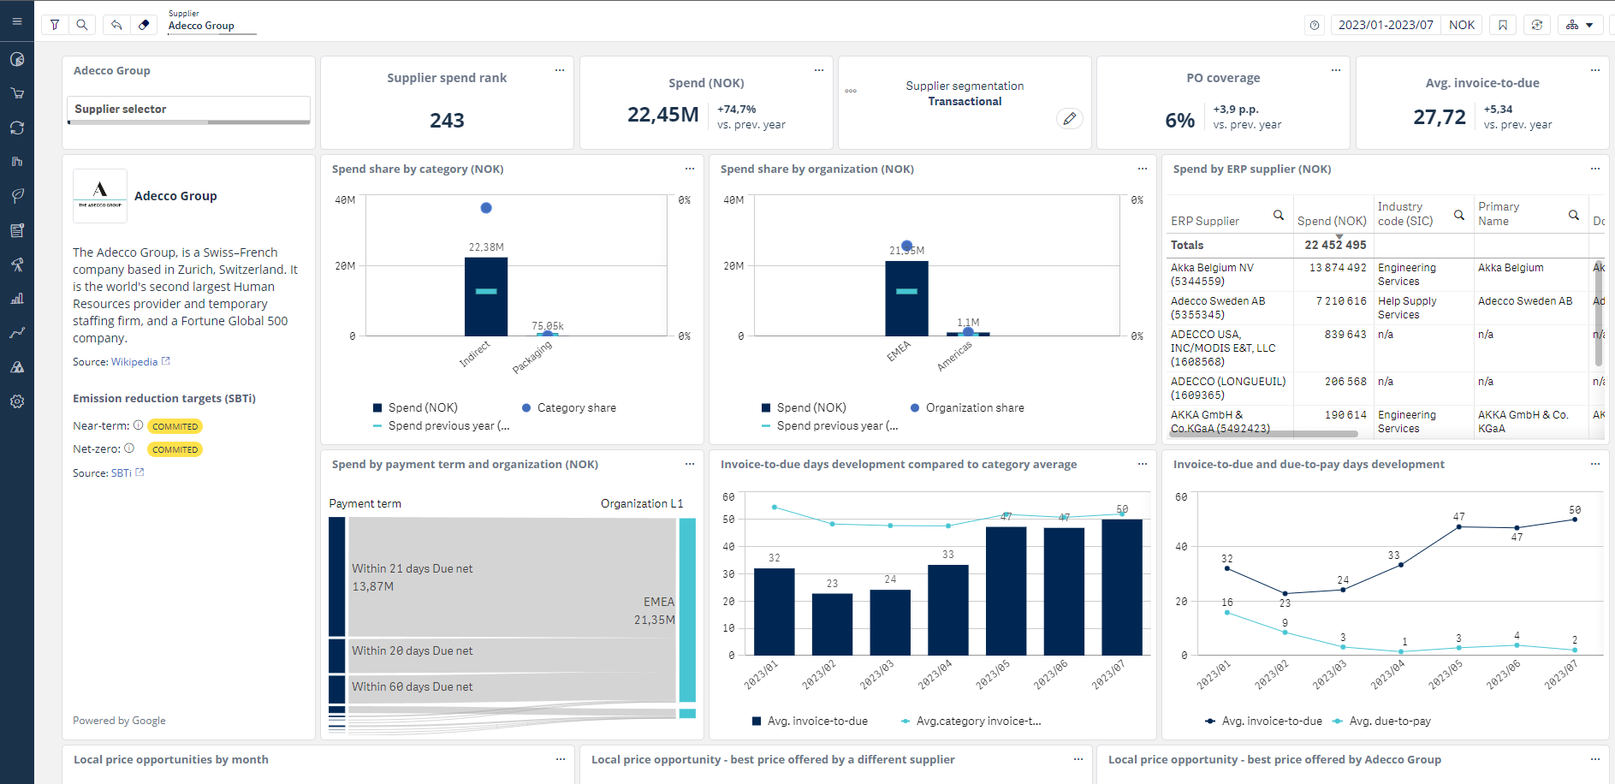
Our goal is to identify what is relevant and offer it in a neat package
Notes:
Goal is to offer the relevant part of it to our customers in a neat package

Slide 13
The challenge
Explore public data to find information relevant for procurement
Sustainabilty
Supply chain
Market events
Process the infomation
Match the data with our central supplier data
Create an interface to track/visualise the information

Slide 14
Why Sievo?
Real project with thousands of users
Make an impact through the biggest customers
Learn from top notch professionals
Summer employment option
Central location, lunch benefit & pool table!
Unlimited coffee, fruits etc.

Slide 15

THANK YOU!

